Slide 1



WASTE

Slide 2

Rights of Use
All of the project educational resources are distributed under an Attribution-NonCommercialShareAlike 4.0 International license (CC BY-NC-SA 4.0). https://creativecommons.org/licenses/by-nc-sa/4.0/deed.en
This license lets others remix, tweak, and build upon our work non-commercially, as long as they credit and license their new creations under identical terms. All of these educational resources can be reproduced and re-used, with the following attribution/credit, both in print and digital format.
Statement of originality
This output contains original unpublished work except where clearly indicated otherwise. Acknowledgement of previously published material and of the work of others has been made through appropriate citation, quotation or both.

Slide 3
Clarifying important concepts and terms
The list below contains the main concepts to be used in this methodology:
Energy – is an abstract physical quantity that relates to the capacity to produce action and/or movement, which can be expressed in many forms: kinetic, chemical, potential, etc.
Energy poverty – is the inability of households to maintain adequate levels of energy services at an affordable cost.
Climate Change – refers to global climate variation or regional climate changes that occur over decades and affect the balance of ecosystems.
Sustainable Development – ”meeting the needs of the present without compromising the ability of future generations to meet their own needs”. (UN, 1987)
Intergenerational Commitment - is a moral and ethical obligation related to sustainability which includes the defence of a healthy environment as a duty and inalienable right of current and future generations.

Slide 4
Module 4 – Waste
Lesson Plan
Aim: To reflect on personal values, identify and explain how values vary among people and over time, while critically evaluating how they align with sustainability values.
Objectives: To know the life cycle of different consumer goods. Incorporate responsible consumption practices.
Proposed Activities from WP3-A1
Introduce the concept of waste and its impact on the environment and let seniors share their perceptions of waste (or examples they have encountered). Use a visually engaging presentation to explain the stages of the life cycle of consumer goods and discuss the environmental impacts associated with each stage and emphasize the importance of waste reduction and responsible consumption.
Present practical tips and strategies for seniors to adopt responsible consumption habits. Then distribute personal action planning worksheets or provide a whiteboard for seniors to write down their commitments (e.g., reducing single-use items, practicing recycling and composting, and supporting local sustainable initiatives).

Slide 5
Module 4 – Waste Connection to WP3
WP3 structure |  | WP3 unit topics
1. Living sustainably
Aim: To reflect on personal values, identify and explain how values vary among people and over time, while critically evaluating how they align with sustainability values |  | 1A - Intergenerational Responsibility
 |  | 1B – Waste
 |  | 1C - Green Economy
2. Problems of the world today
Aim: To manage transitions and challenges in complex sustainability situations and make decisions related to the future in the face of uncertainty, ambiguity and risk. |  | 2A - Adaptation to climate change
 |  | 2B - Mitigation to climate change
3. Energy: Resources, Poverty & Sustainability
Aim: To identify own potential for sustainability and to actively contribute to improving prospects for the community and the planet. |  | 3A - Energy resources
 |  | 3B - Energy poverty
 |  | 3C - Energy sustainability
 |  | 3D - Sustainable mobility
WP4 TRAINING MODULES
1. Green ABC
2. House performance
3. House renovations
4. Waste
5. Sustainable mobility
6. Sustainable food
7. Biodiversity and zero pollution

Slide 6
Table of content
Different types of waste and their recycling
Circular Economy
Purchase Sustainable Products and Identify Greenwashing

Slide 7
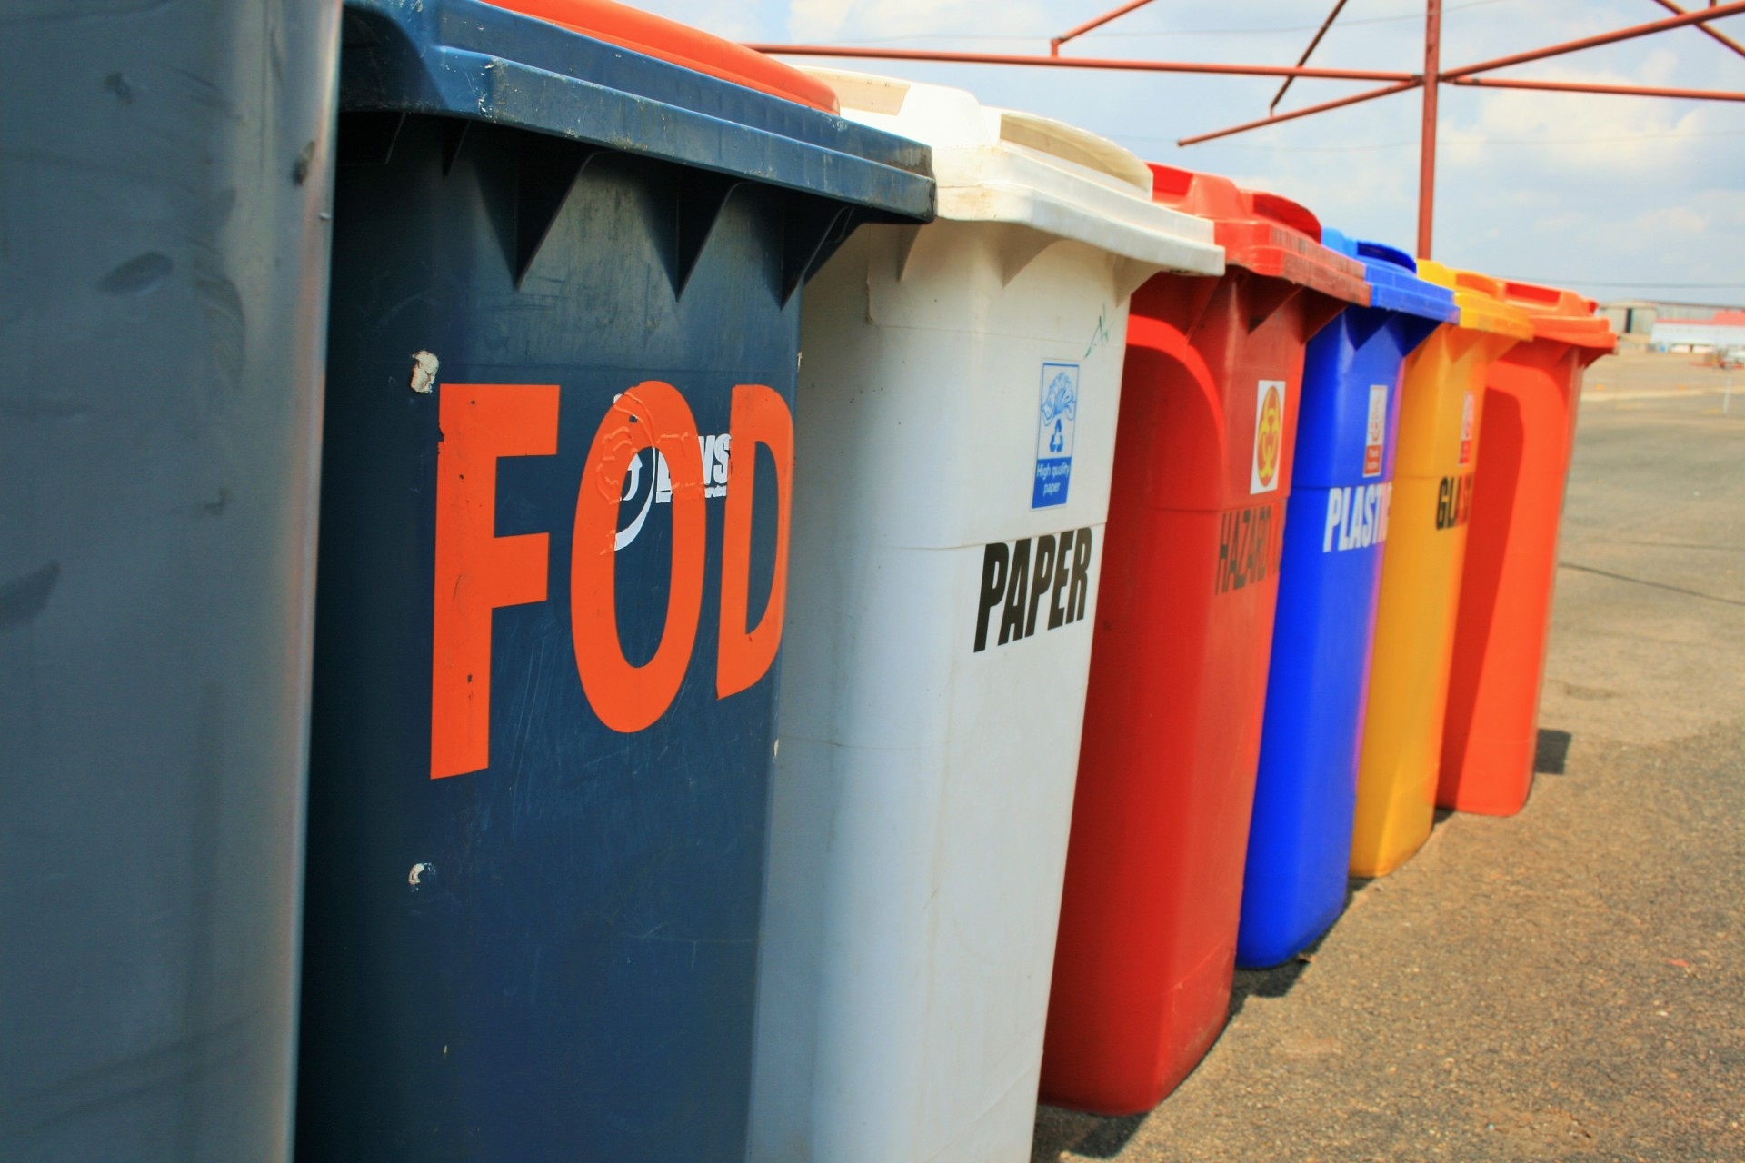
1) Different types of waste and their recycling
Learn about waste management methods of rural senior households.
Notes:
Elders living alone can greatly contribute to reducing waste and crafting a more efficient recycling system

Slide 8
Waste management in EU
5 tonnes of waste Only 36% Over 60%
is produced by the average European each year
of waste in the EU is recycled
of household waste still goes to landfill in some EU countries
The EU wants to promote
the prevention of waste and
the re-use of products as much as possible.
If this is not possible,
it prefers recycling (including composting),
followed by using waste to generate energy.

Slide 9

Benefits of Recycling
Recycling is a critical process that helps:
1
Reduce landfill waste
Conserve natural resources
2
3
Prevent pollution
Notes:
1) By recycling materials, we can reduce the amount of waste sent to landfills, which reduces methane emissions and extends the life of landfills.
2) Recycling reduces the need for new raw materials, which helps conserve natural resources like trees, minerals, and crude oil.
3) Recycling helps reduce air pollution, water pollution, soil contamination associated with mining, manufacturing, and waste disposal, which can improve human health and environment.

Slide 10
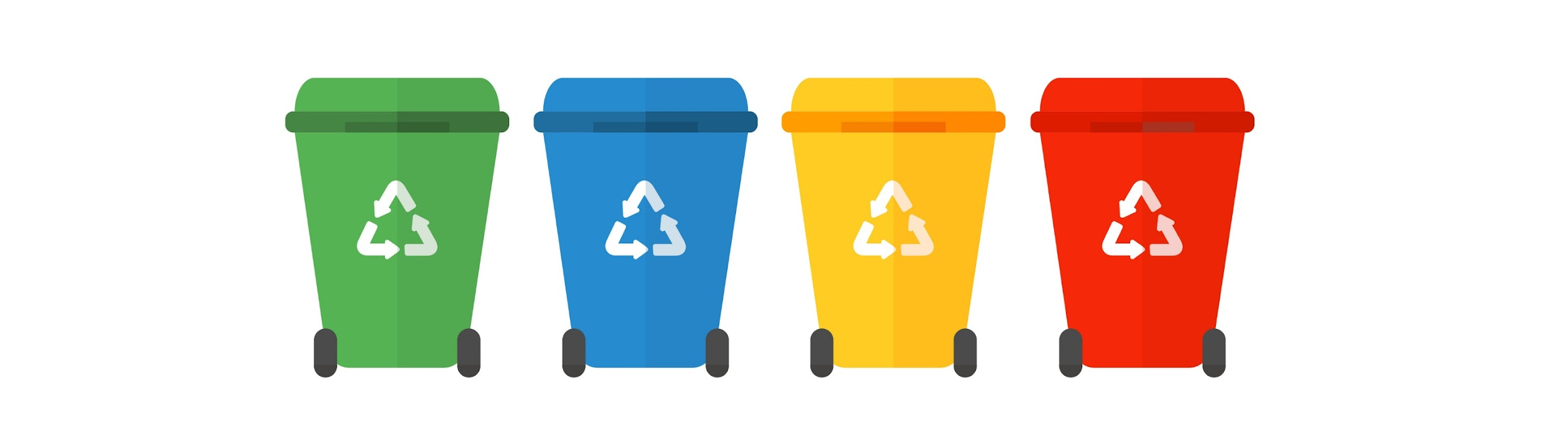
Support for the elderly
Bins with wheels
Regular waste disposal
Accessible bins and clear instructions
Source of image: Adobe Stock
Notes:
Getting bins with wheels for easier mobility!
Regular disposal of waste is important to prevent bins from becoming too heavy, so encouraging more frequent disposal instead of weekly can be helpful.
Ensuring the bins are easily accessible and providing clear instructions, such as labels or color-coding, can make the process more manageable for elderly individuals.

Slide 11
Every waste in its right place.
PAPER | PLASTIC | METAL
GLASS | ELECTRONIC DEVICES | HAZARDOUS WASTE

Slide 12
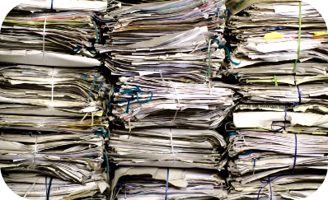

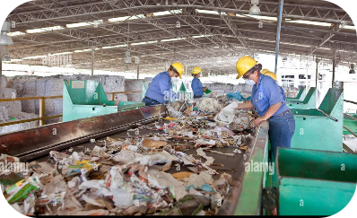
Paper and Cardboard Recycling
Process
End Products
Benefits
Paper and cardboard are collected, sorted, and cleaned. Fibers are turned into pulp and used to make new products.
Newspapers, magazines, paper towels, tissues, cardboard boxes, writing paper
Reduces the number of trees cut down, saves energy, and reduces green-house gas emissions.

Slide 13

How do you utilise old newspapers?
Class Exercise
Notes:
We can use old newspapers for:
Composting
Protecting fruits and vegetables from cold
Creative hobbies
Wrapping books/presents, etc.

Slide 14
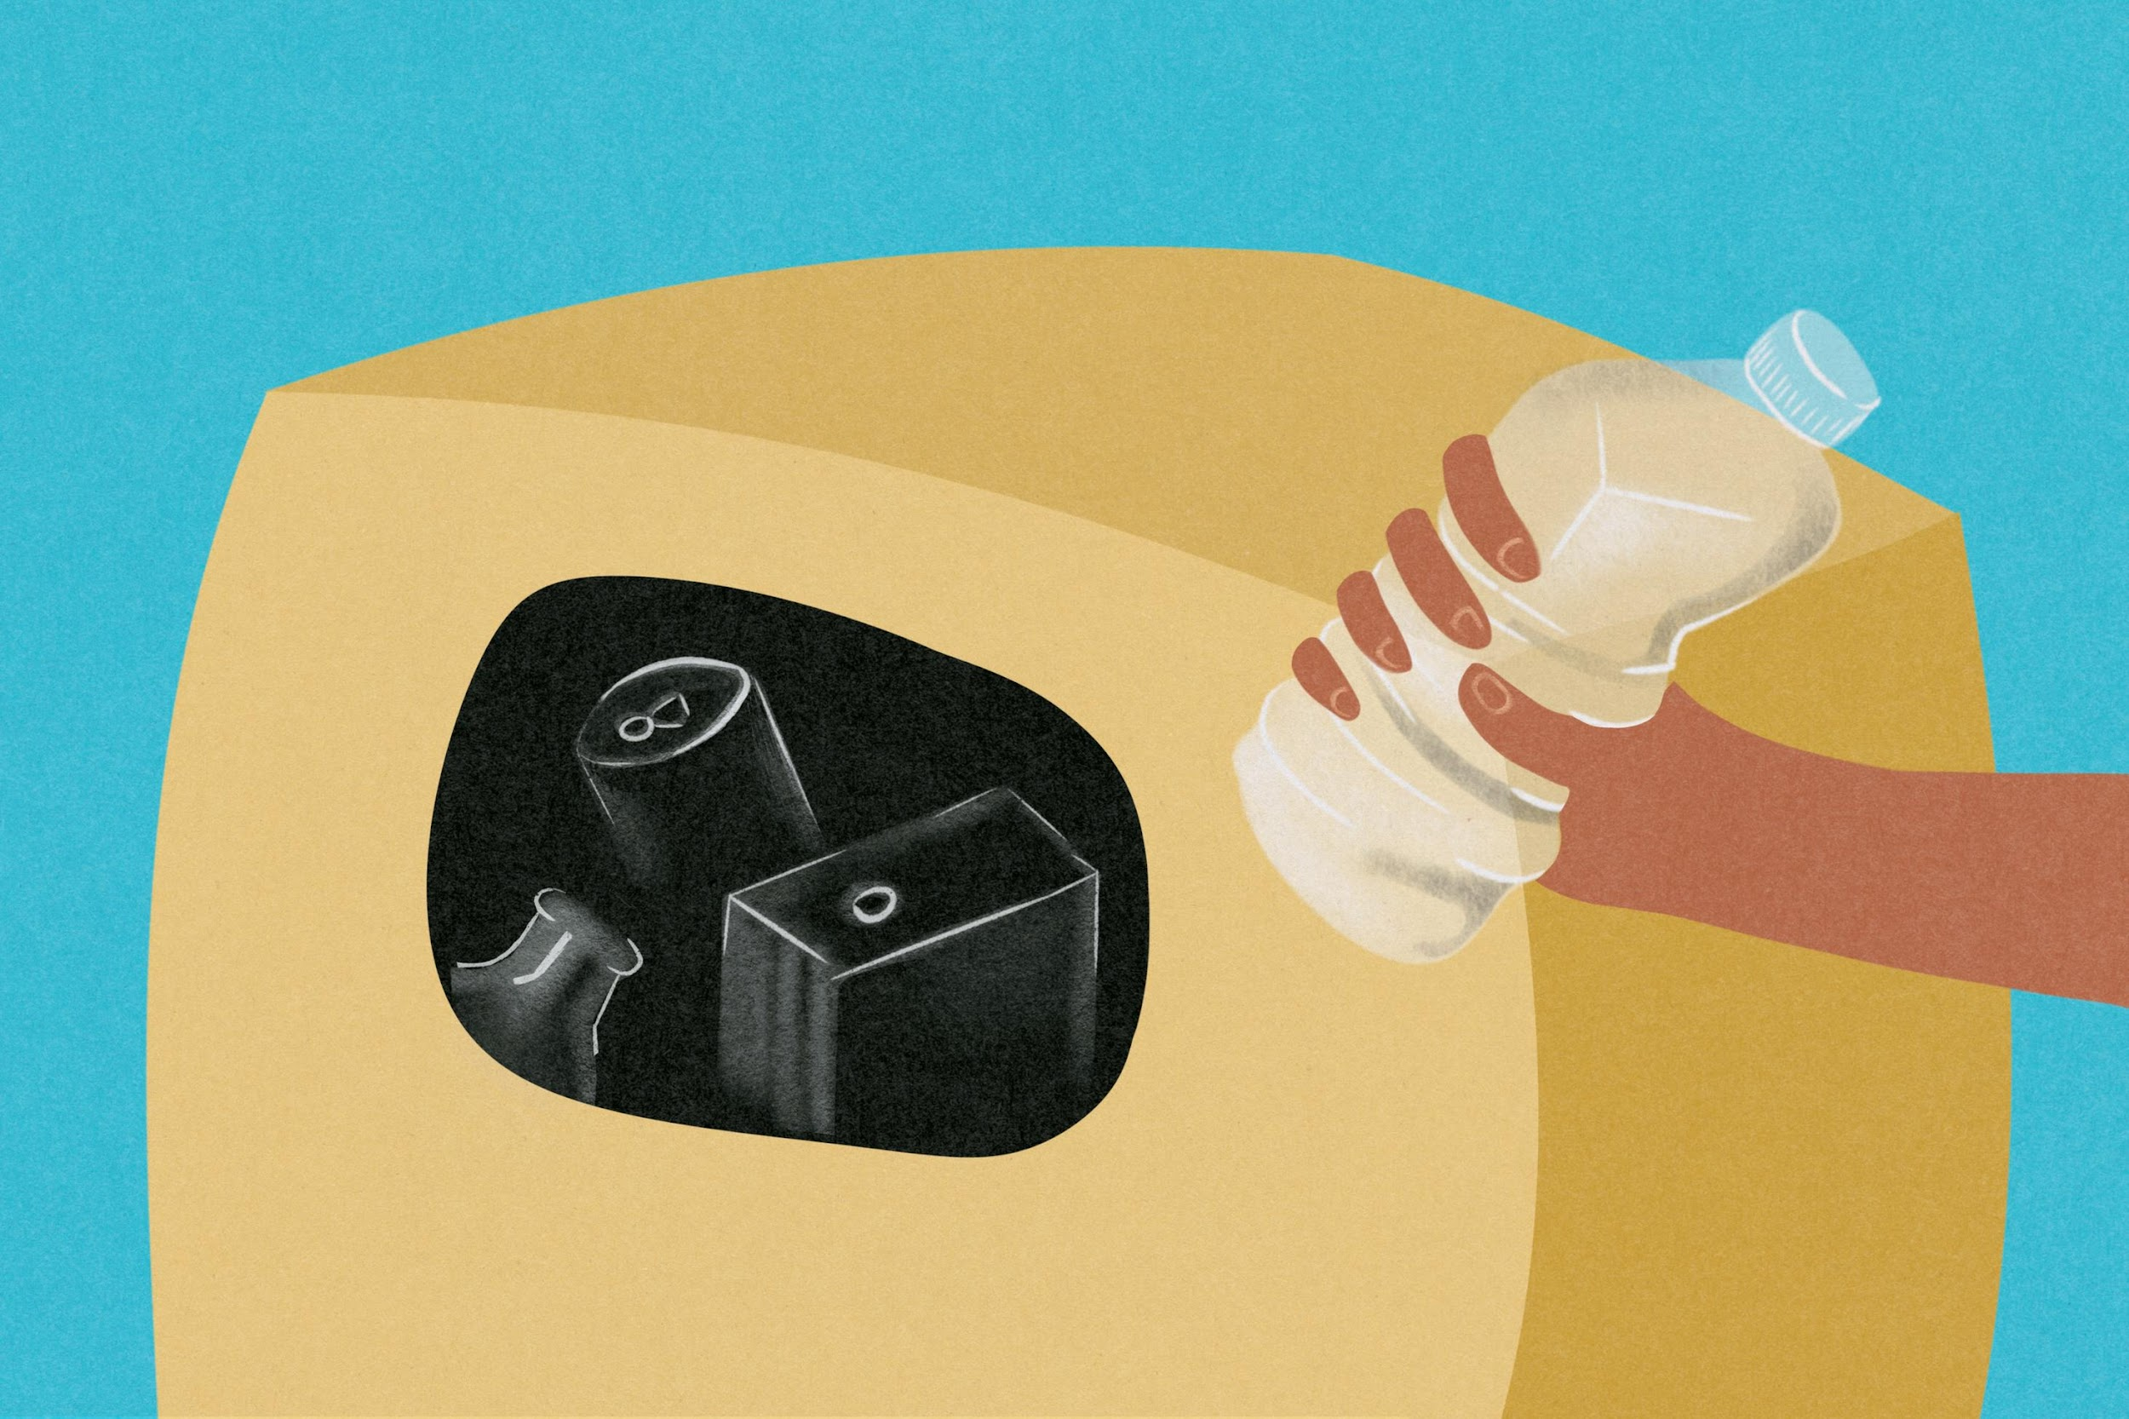
Plastic Recycling
There are 7 different types of plastics,
each with unique chemical properties.
Recycling Process
Plastic is shredded, melted, and reformed into new products. The polymer code on plastic items indicates the type of plastic it is made of and whether it can be recycled.
Notes:
Types of Plastics: PET, HDPE, PVC, LDPE, PP, PS, and other plastics.

Slide 15
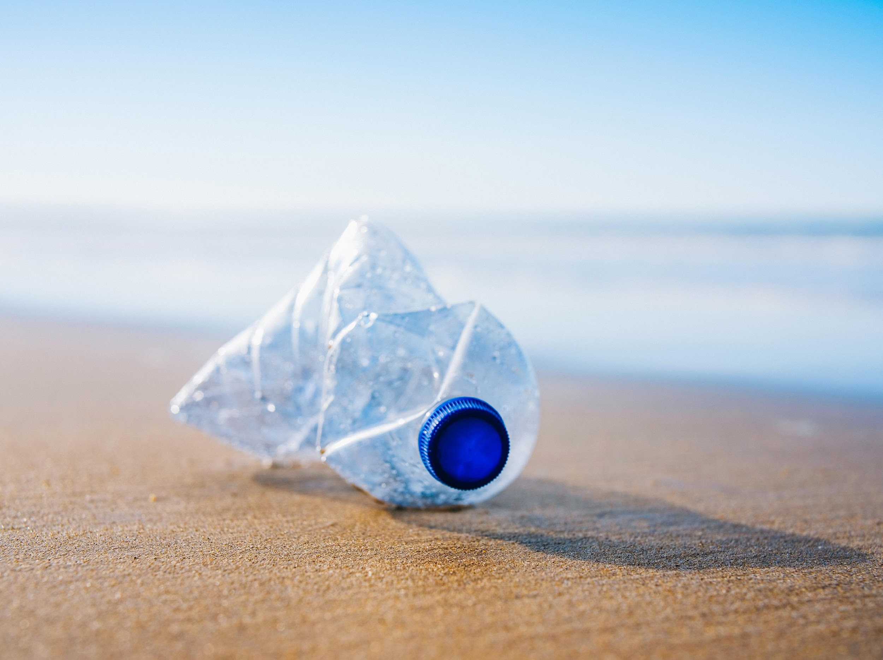
Plastic Recycling
Benefits
Reduces energy use
Saves oil reserves
Reduces greenhouse gas emissions
Keeps plastic from ending up in the ocean and damaging marine ecosystems

Slide 16

Plastic Recycling
Challenges
Contamination
Low recycling rates
Difficulties in collecting and sorting
Lack of proper infrastructure
Uplifting demand for recycled plastic, etc.
Notes:
Although we can recycle plastic waste several times, it has its limits.

Slide 17
How to reduce your plastic waste?
Avoid cellophane-wrapped products
Store your leftovers without using plastic
Avoid tea bags and use a tea strainer
Use natural sponges or luffa instead of plastic sponges
Reuse your plastic bottles
Use bar of soap instead of liquid products
Notes:
UNICEF and Austrian Development Agency have collected some tips on how households can reduce their plastic consumption.

Slide 18
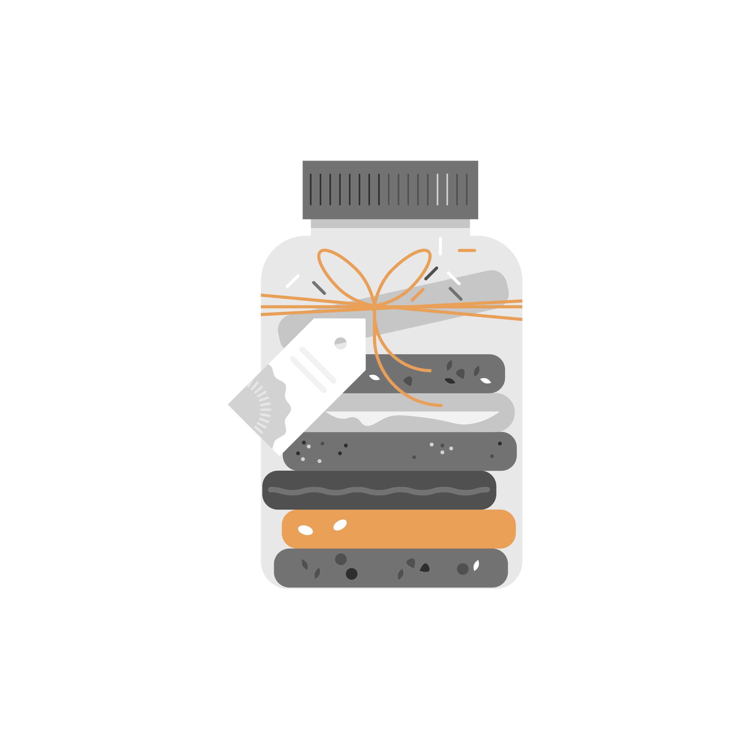
Glass Recycling
1
Collection and Sorting
Glass is collected, sorted, and transported to recycling centres.
2
Cleaning and Crushing
The glass is washed and crushed into small pieces called cullet.
3
Melting and Moulding
The cullet is melted and moulded to create new glass bottles, jars, and other products.

Slide 19

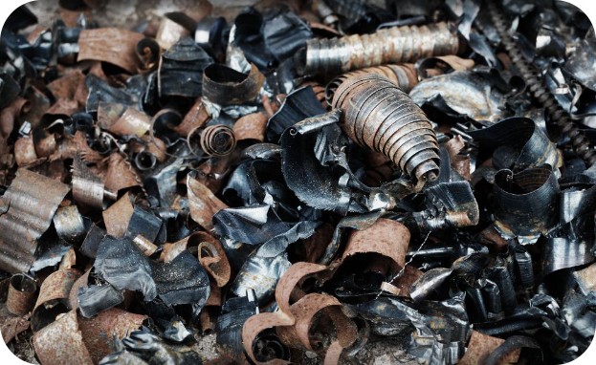
Metal Recycling
Process
Benefits
Metal is collected, sorted, and processed. It is then melted and moulded into new products, such as cars, bicycles, and cans.
Recycling metal helps conserve natural resources, reduce greenhouse gas emissions, and lower energy use. It also reduces the need for mining new metals.

Slide 20
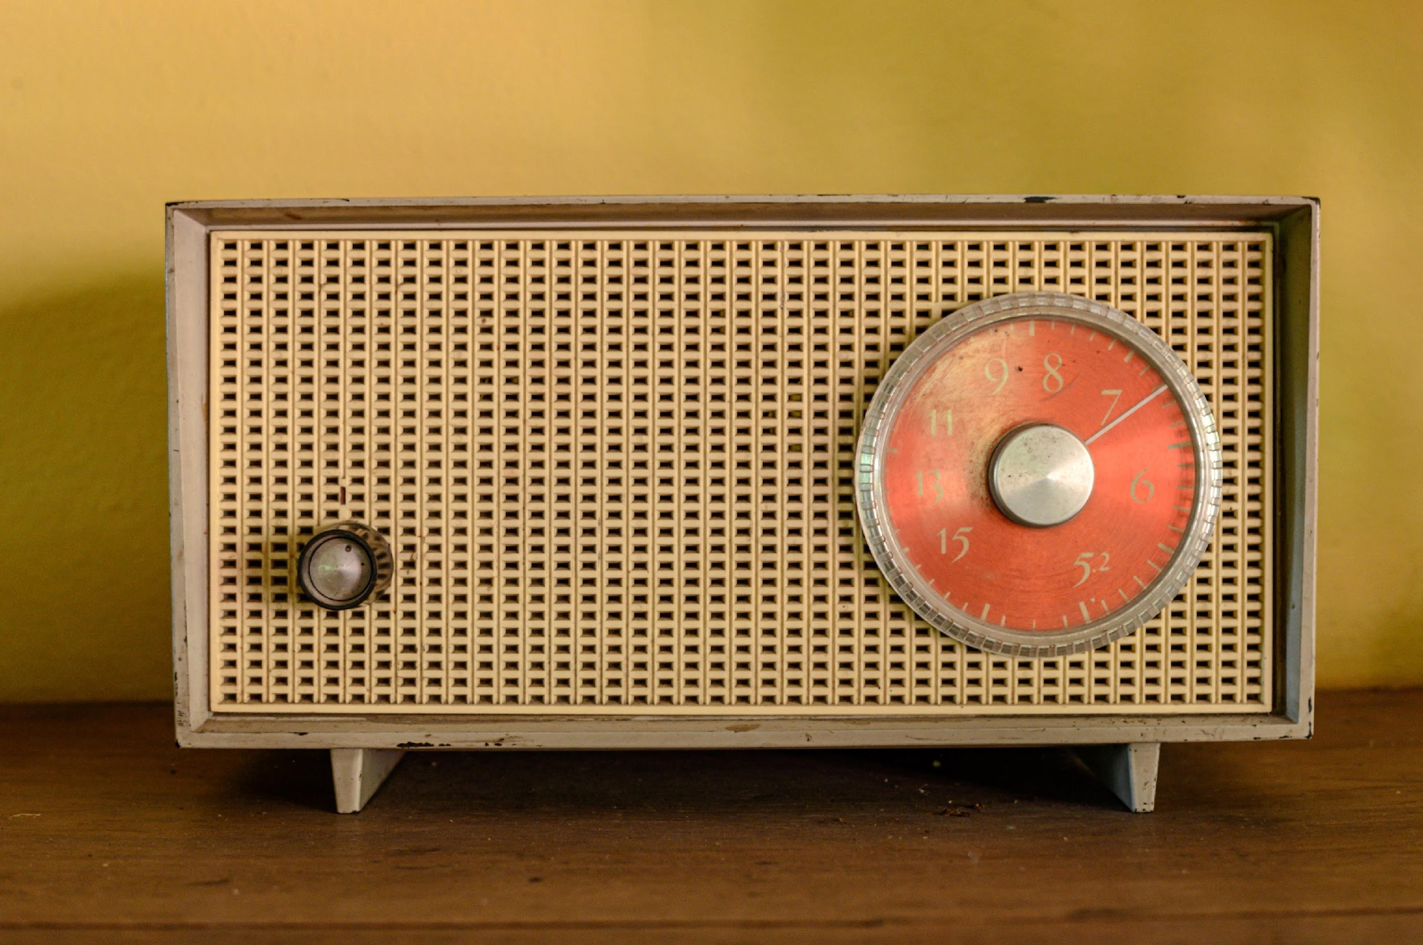
Electronic Waste Recycling
1
What is E-Waste?
2
Recycling Process
Old or outdated electronics like computers, televisions, cellphones, and other electronic equipment.
Electronic waste is collected, sorted, and disassembled. The components are then processed and refined to recover valuable metals and other materials.

Slide 21

Electronic Waste Recycling
Benefits
reduces landfill waste
conserves natural resources
prevents the release of toxic chemicals into the environment

Slide 22

Electronic Waste
Recycling Challenges
data security
exportation to developing countries
need for specific recycling technologies

Slide 23


Hazardous Waste
Examples
Medicine/Clinical waste
Batteries, the used cooking oil, pesticides, used tyres, light bulbs, construction waste, paint, medicines, etc. are hazardous and require special treatment.
Unused meds should be returned to the pharmacy or a local drop off site to ensure safe disposal.

Slide 24
The Future of Recycling
Benefits
Circular Economy
The future of recycling is promising; it will help conserve natural resources, reduce pollution, and create new jobs.
A circular economy aims to keep resources in use for as long as possible, reduce waste, and promote recycling and innovation.
Technological Advancements
Innovations, such as robotics and artificial intelligence, are making recycling more efficient and accurate.

Slide 25
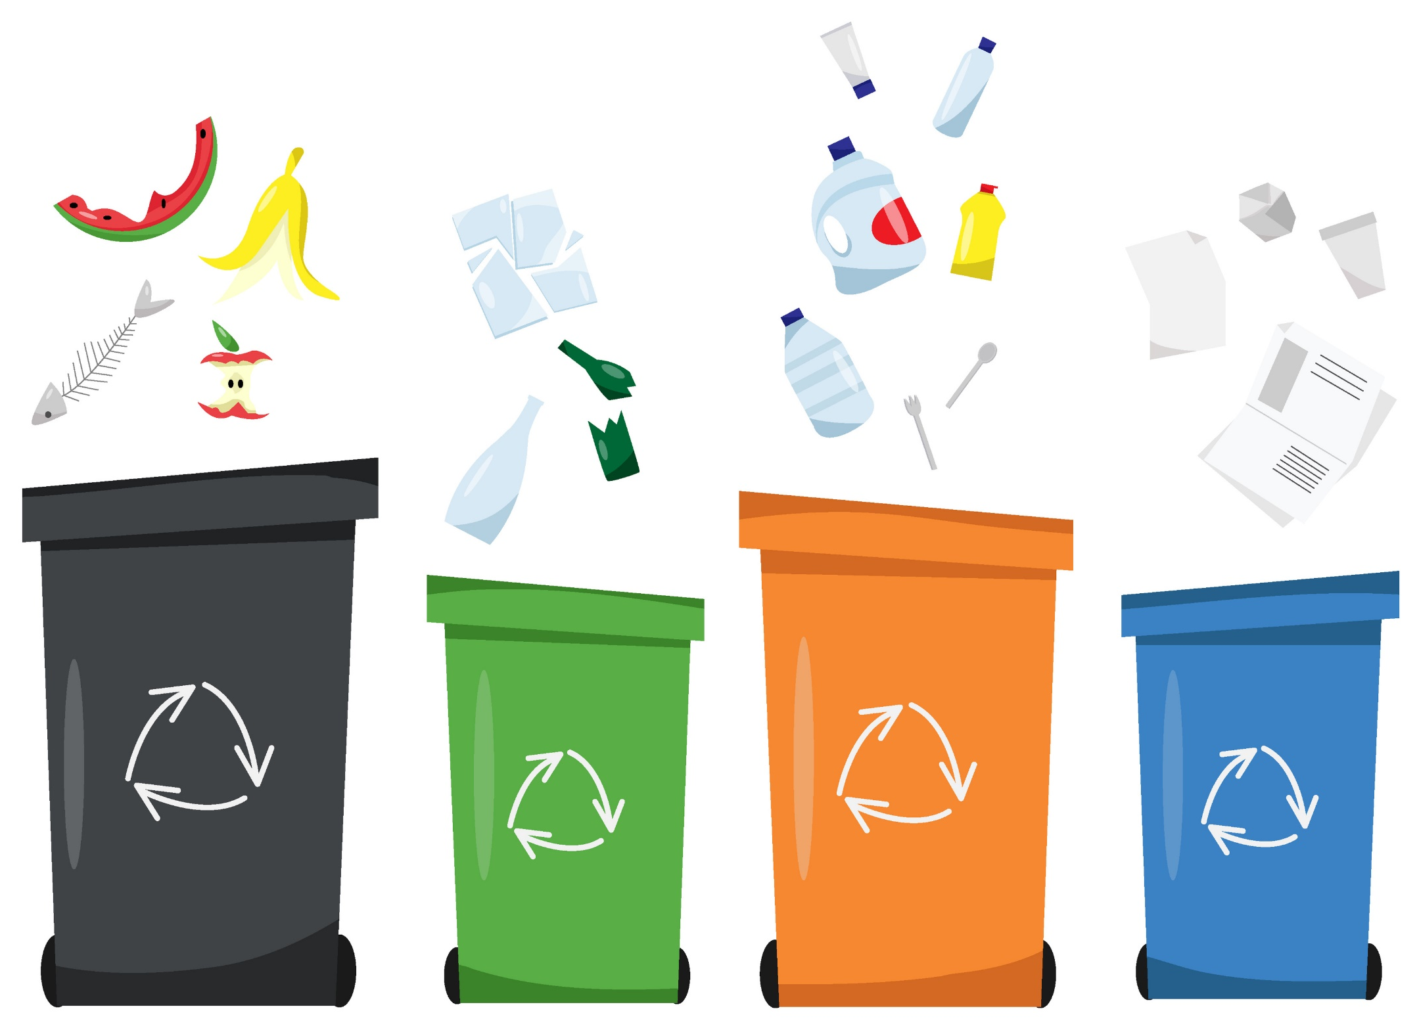
Conclusion
Recycling is an essential process that helps reduce waste, conserve natural resources, and prevent pollution. By recycling commonly used materials like paper, plastic, glass, metal, and electronic waste, we can make a difference for the environment and future generations.
Source of image: Adobe Stock

Slide 26
References
United Nations Brundtland Commission: Report of the World Commission on Environment and Development: Our Common Future
Randall, A. On Intergenerational Commitment, Weak Sustainability, and Safety. Sustainability 2020, 12, 5381. https://doi.org/10.3390/su12135381
Easy Recycling Tips for Seniors
European Commission – Environment
Exploring the three Rs of waste management — Reduce, Reuse, Recycle.
“Let’s take out the trash!” A guidebook for local governments and CBOs to support elderly people.
Waste management in the EU: infographic with facts and figures
UNICEF: 9 ways to reduce plastic waste at home

Slide 27
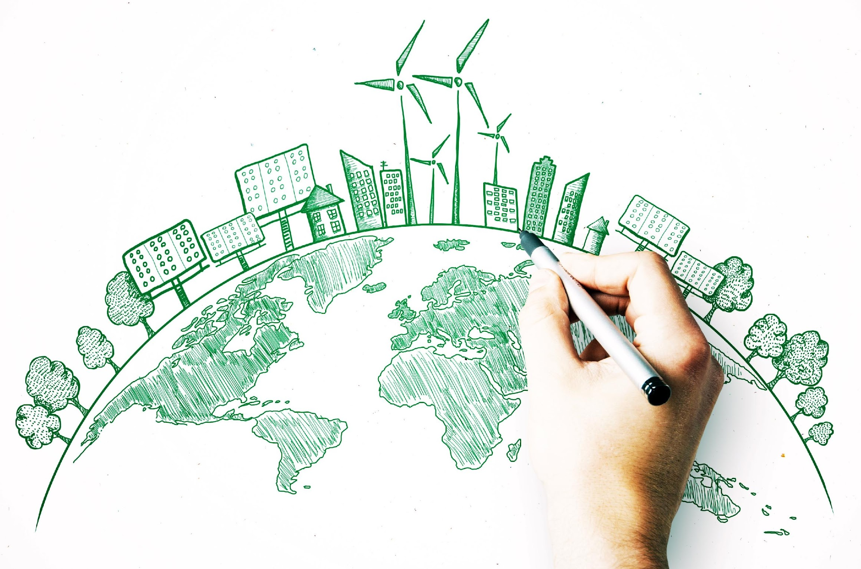
2) Circular Economy
Welcome to the world of circular economy where waste is transformed into resources, and sustainability is at the core of every decision.
Join us on this
journey!
Source of image:
Stock Adobe

Slide 28
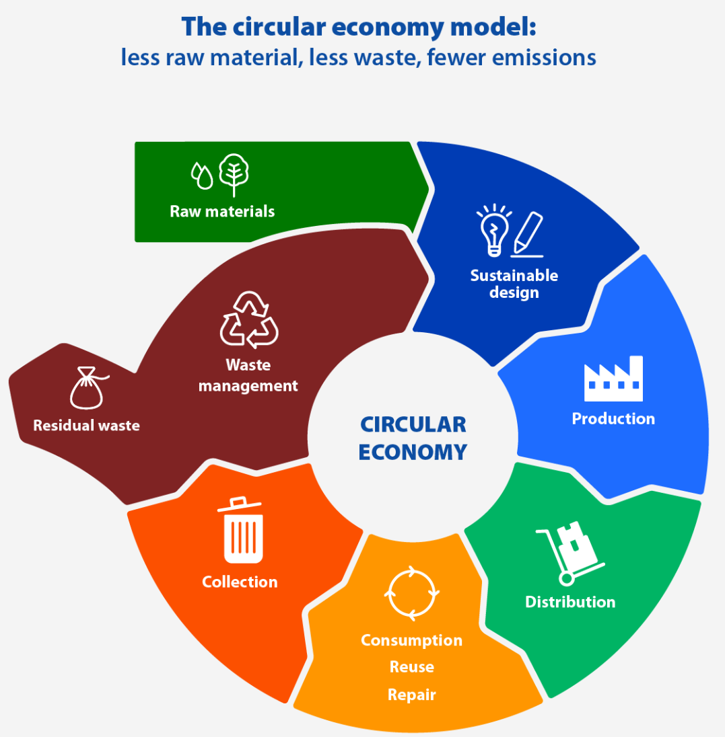
The Model
The principles of circular economy, which is a model of production and consumption, are based on reducing, reusing, and recycling resources. By embracing this approach, businesses can cut costs, reduce waste, and create a more sustainable future for all.
Source of image: European Parliament Research Service

Slide 29

Benefits
reduced greenhouse gas emissions
reduced raw material dependence
increased resource efficiency
economic growth & job creation
save money

Slide 30
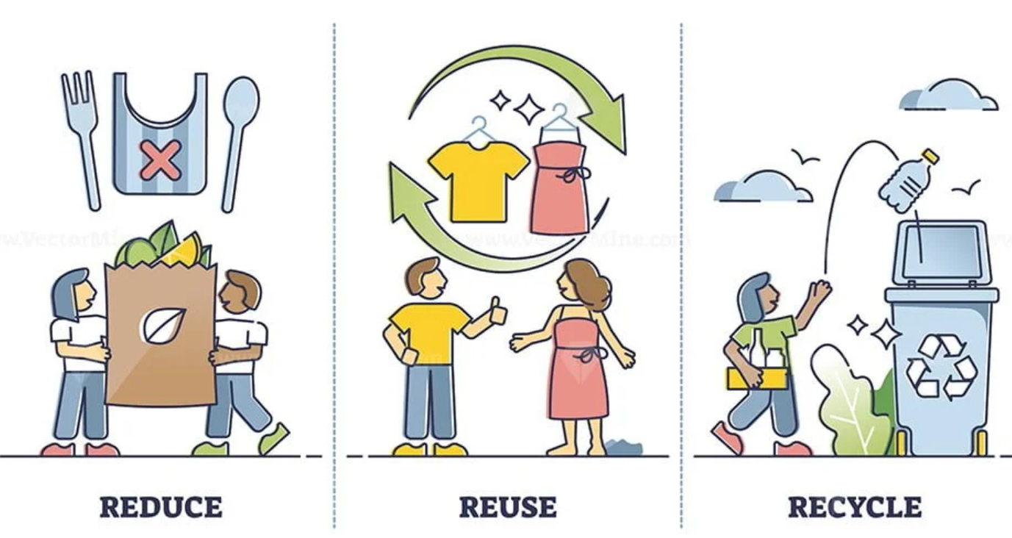
The Three Rs of Circular Economy
REDUCE
REUSE
RECYCLE
Source of image: www.pixabay.com
Video: How to Build a Circular Economy | Ellen MacArthur Foundation

Slide 31



What you can do for it?
Craft a new hobby! Cooperate with family members!
Upcycling and Crafting
Cooking and Baking
DIY Home Maintenance
Notes:
1. Upcycling and Crafting: Repurposing old items into new ones or creating crafts from recycled materials can be a creative and fulfilling hobby. It reduces waste and gives old items new life.
2. Cooking and Baking: Experimenting with cooking and baking can be enjoyable and practical. Making meals from scratch reduces the need for processed foods and packaging.
3. DIY Home Maintenance: Learning basic home maintenance skills like repairing clothing, fixing appliances, or doing simple carpentry can extend the lifespan of items and reduce the need for replacements.

Slide 32
What can you gain from it?
Learn to save money!
Handyman crafts: elderly individuals with skills in carpentry, plumbing, jewelry or knitting can offer their services to others in their community with materials they already have.
Clean out your closet regularly and sell your unused clothes.
Notes:
A safer and more organized home lets you age in place longer.

Slide 33
Challenges and Barriers
3
Policy and Regulation
Creating an enabling environment through supportive policies and regulations will drive the transition to a circular economy.
2
Infrastructure
Investments and collaborations are needed to establish robust collection, sorting, and recycling systems.
1
Mindset Shift
Changing traditional linear thinking to embrace circularity can be a challenge.
Notes:
Extended Producer Responsibility (EPR):
Makes manufacturers responsible for the entire lifecycle of their products, including collection and recycling.
Plastic Bag Bans:
Restrictions on single-use plastic bags encourage consumers to use reusable alternatives.
Deposit-Return Schemes:
Encourage consumers to return beverage containers for recycling by offering a financial incentive.
Green Public Procurement:
Government agencies and organizations prioritize the purchase of environmentally friendly products and services.

Slide 34
Circular Economy
Class Exercise
Share stories/old habits from the good old days when everything in your household was either recycled or reused.
What do you do nowadays to reduce the amount of waste you produce?

Slide 35
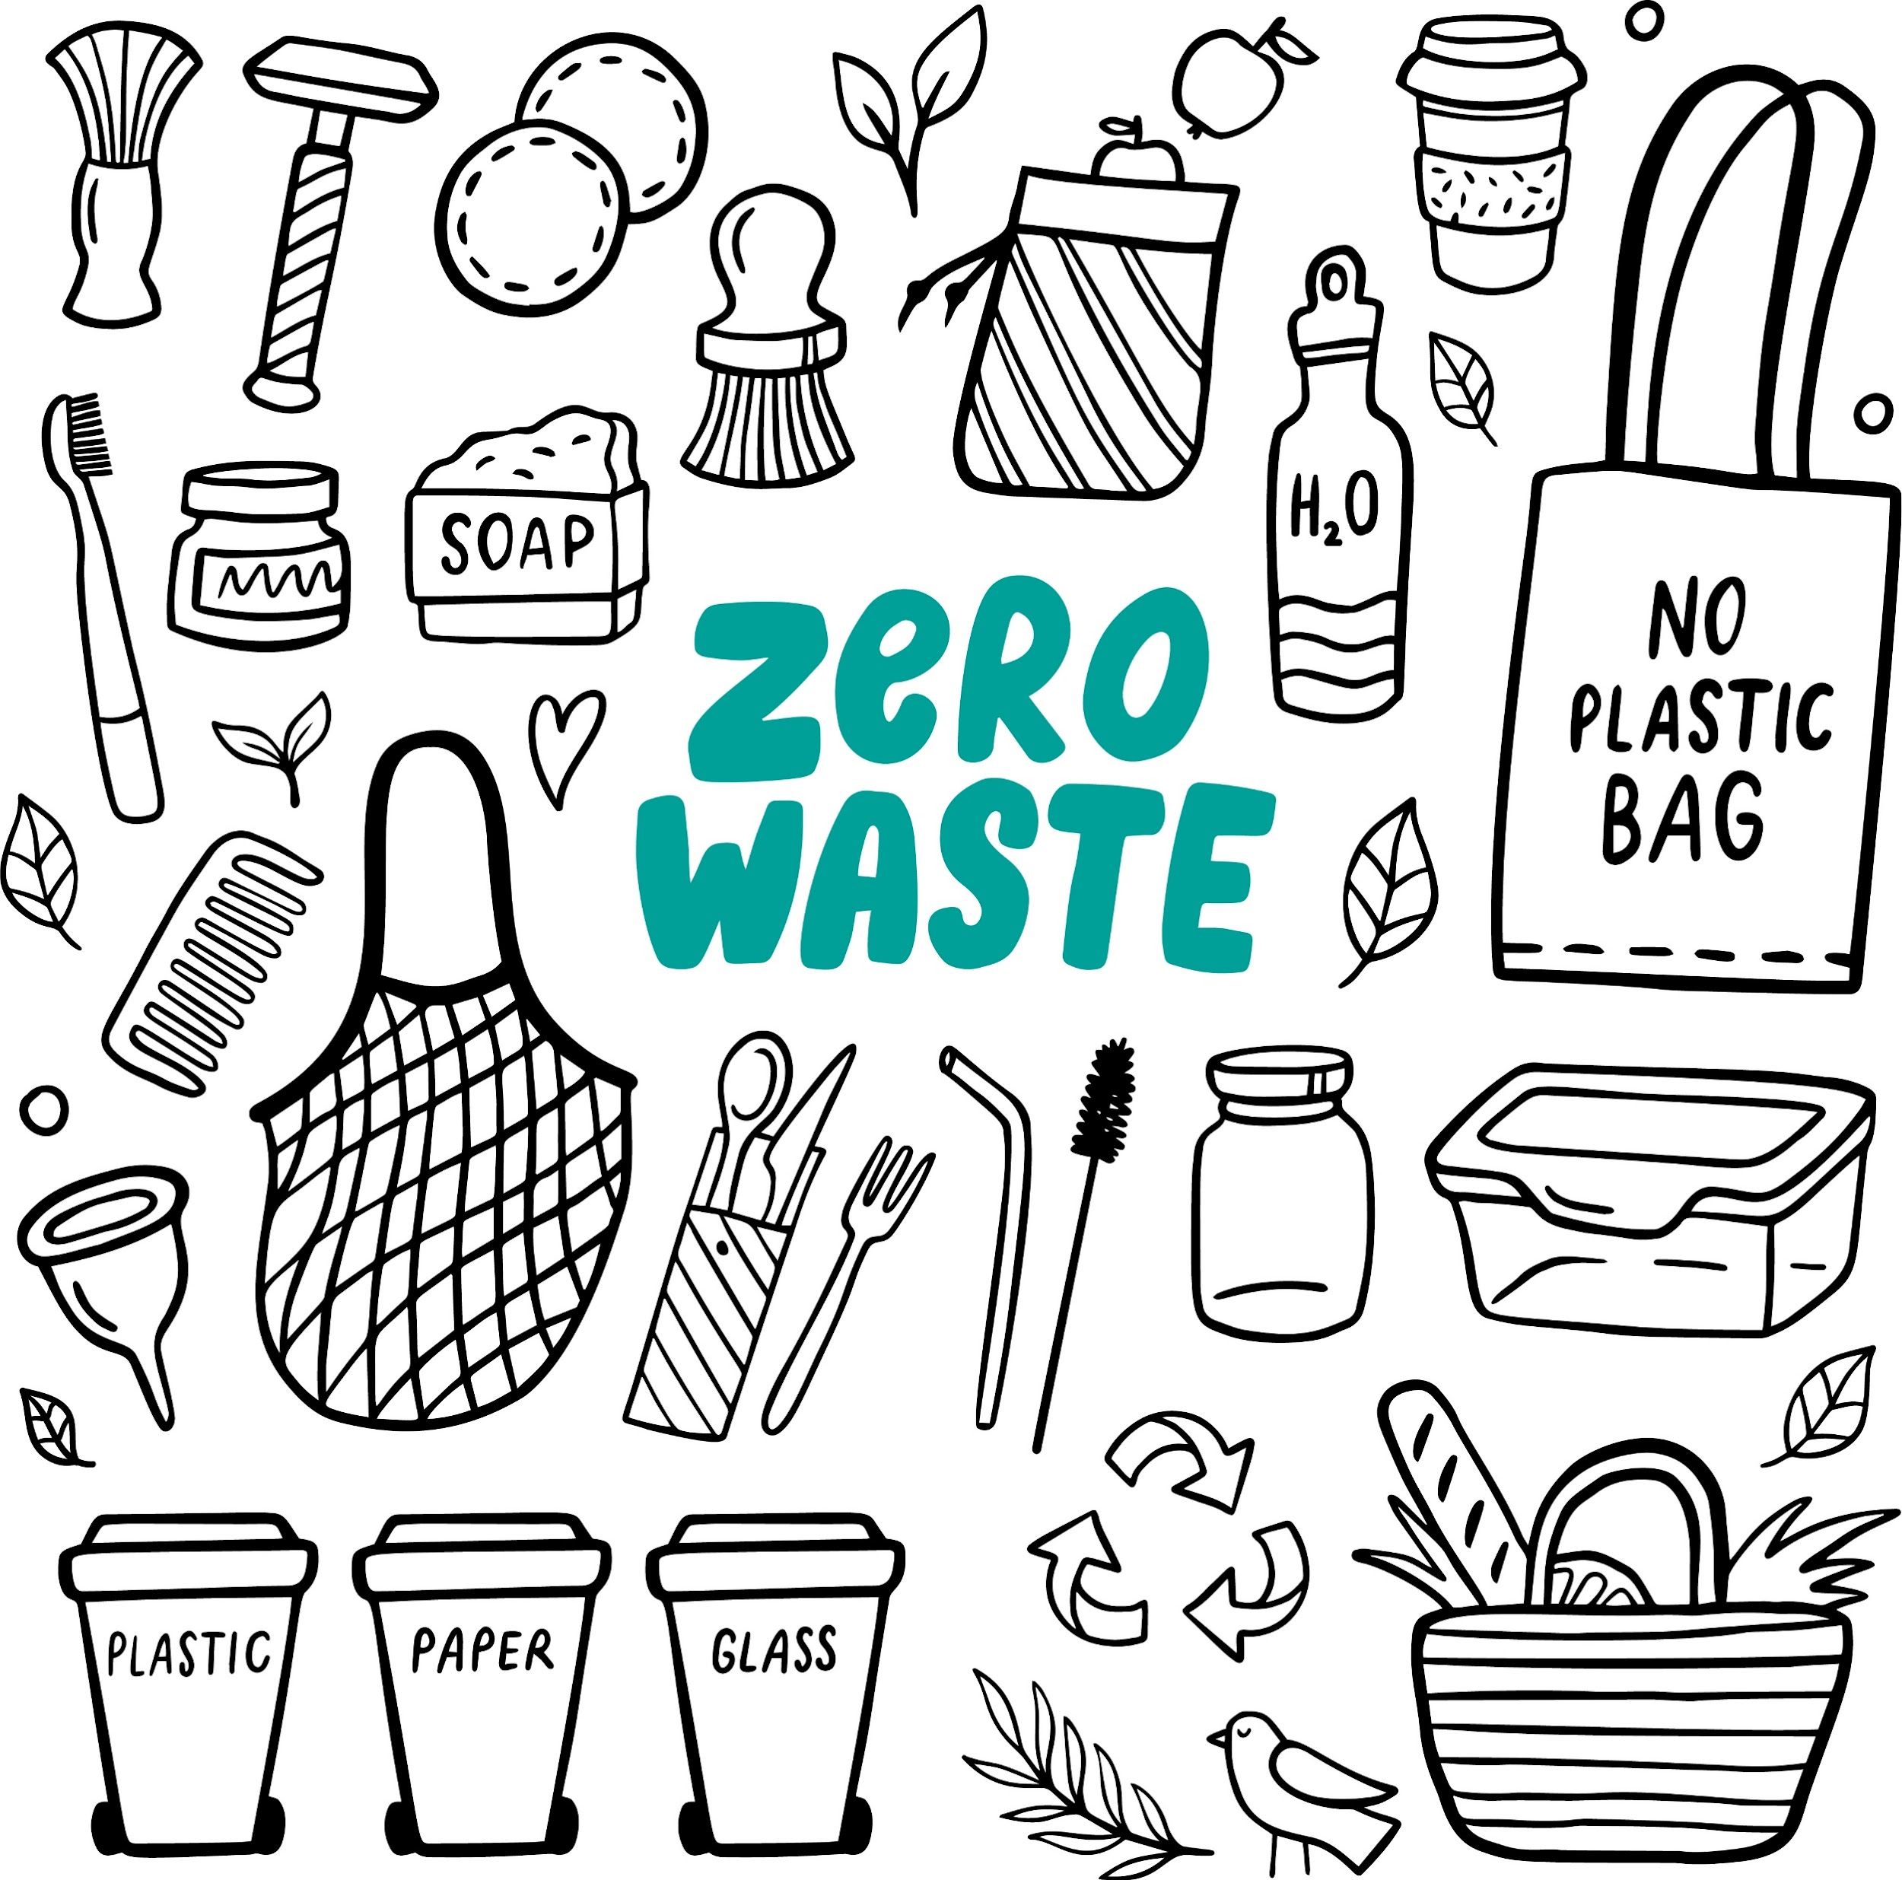
How can you reduce your waste?
Buy high-quality products with long life span
Choose products which can be repaired if necessary
Prefer reusable products instead of disposal/non-refillable ones
Always ask yourself if you really need that item
Prepare weekly menu in advance to avoid food waste
Try to avoid plastic bags and packaging
Compost your green waste
ZERO WASTE
Source of image: Adobe Stock

Slide 36
Conclusion
The circular economy is a necessity for a sustainable future. By embracing circularity, we can create a world where waste is minimized, resources are maximized, and everyone benefits.
References
Circular economy: definition, importance and benefits | European Parliament

Slide 37

3) Purchase Sustainable Products and Identify Greenwashing
Explore the importance of sustainable products in today's world and learn how to identify and avoid greenwashing.

Slide 38
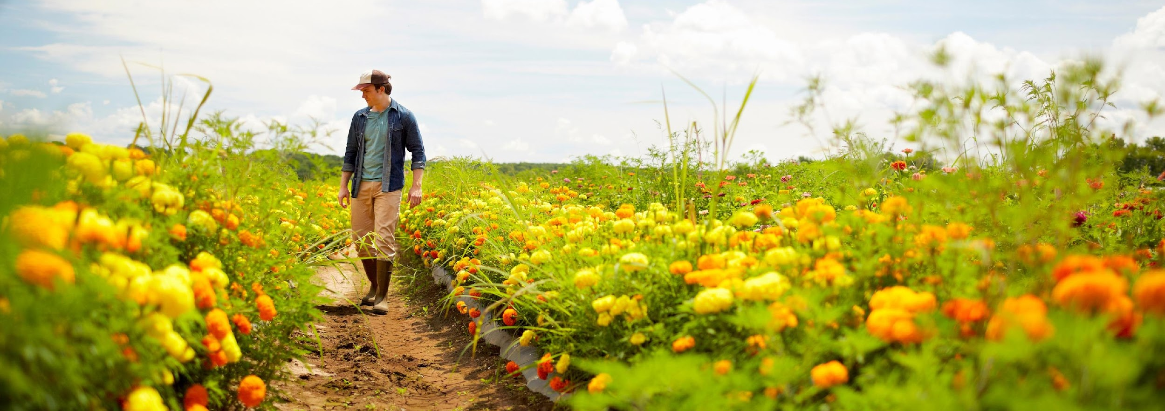
What makes a product sustainable?
Source: What Is a Sustainable Product? The Complete Guide
Life cycle sustainability the total impact on the environment throughout its entire lifespan. | Ecological and social impact the fair, ethical treatment of workers, sharing on the profit, low environmental impact. | Positive contribution to humanity the positive impact the brand has through charitable actions.
Notes:
Life cycle sustainability:
The sustainability of a product's life cycle hinges on its overall environmental footprint from inception to disposal.
1. Sourcing raw materials
2. Manufacturing processes
3. Distribution methods
4. Consumer usage patterns
5. Disposal practices.

Slide 39
Sustainable Product is…
“…a product that is made with responsible materials, produced in an ethical way, has an efficient life cycle and can be disposed of with minimal impact.”
/Jo Vieira: What makes a product sustainable?/

Slide 40
Benefits of sustainable purchasing
reduce carbon emissions, e.g. by buying energy efficient products
save natural resources, e.g. by choosing products and services that use recycled materials or waste as resource
reduce waste sent to landfill, e.g. by buying products which can be reused or recycled
help communities, e.g. by creating work for local suppliers or buying goods traded fairly to improve living and working conditions

Slide 41
Tips for Purchasing Sustainable Products
Look for Certifications and Labels
1
Research and Verify Claims
2
Explore trustworthy certifications and labels that justify a product’s sustainability.
Check sustainability claims of companies.
Support Trustworthy Brands and Companies
3
4
Be Aware of Greenwashing Traps
Discover ethical and sustainable brands that prioritize transparency and environmental responsibility.
Stay informed about common tactics used in greenwashing and how to avoid falling for them.

Slide 42
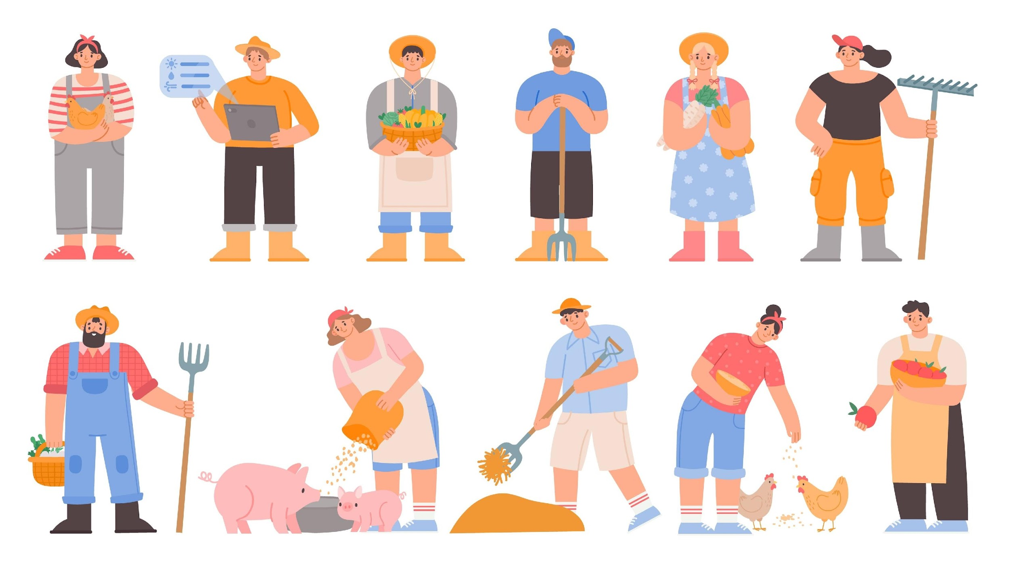
Research and Verify Claims
1
Check where your food is sourced and the methods of manufacturing.
Source of image: Adobe Stock
Notes:
„When buying seafood… make sure the fish are wild-caught with low bycatch rates. Many brands will even list where the fish were caught.
When buying meat… make sure the livestock was raised and treated fairly, instead of factory-farmed. Look for farms that practice free-range, pasture-based farming with a natural diet of healthy ingredients.
Avoid produce sourced from farms that use pesticides or other harmful chemicals. Produce is now starting to use “pesticide-free” labels, which are one step above USDA Organic stickers.„
Source: https://hivebrands.com/blogs/news/what-is-a-sustainable-product

Slide 43



Look for Certifications and Labels
2
Fairtrade: With this label, you can feel comfortable knowing the producer provides fair compensation and working conditions to their employees.
EU Ecolabel is the EU official voluntary label for environmental excellence based on standardised processes and scientific evidence. Goods and services can also get it.
Cradle to Cradle: ”the global standard for materials, products and systems that positively impact people and planet.”
Notes:
Here are a few labels to look for to make sure the products you’re getting are truly offering sustainable benefits

Slide 44
Support Trustworthy Brands and Companies
3
Buy the products of such companies who…
make effort to do something for the environment and/or for the humanity
have transparent sustainability practices and behaviour
display detailed ingredients on their labels, so you know exactly what you’re eating, drinking, or wearing

Slide 45



Be Aware of Greenwashing Traps
4
Be cautious with….
no certification
bad ingredients
misleading imagery
Notes:
„Bad ingredients: Products containing badingredients like parabens, non-RSPO certified palm oil, or synthetic ingredients are massive red flags that they aren’t sustainable.”
„Misleading imagery: A label can be green or have a picture of the planet Earth to make you associate it with sustainability. Look closer at the details on the label to see if they are actually sustainable.”
Source: https://hivebrands.com/blogs/news/what-is-a-sustainable-product
Natural isn’t always more eco-friendly: Natural materials such as viscose, rayon and bamboo are promoted as eco-friendly, but it depends on how they’re sourced. For example, 150 million trees are cut down for viscose production every year. Viscose is responsible for deforestation, unless it comes from a certified source.”

Slide 46
Identifying Greenwashing
Signs and Tactics Used by Companies
Examples of Greenwashing in Various Industries
Definition of Greenwashing
1
2
3
Understand the concept of greenwashing and its implications in misleading consumers.
Explore the strategies employed by companies to create the illusion of sustainability.
Discover real-life instances of greenwashing in different sectors.

Slide 47
Definition of Greenwashing
1
According to the European Supervisory Authorities Greenwashing is:
“a practice where sustainability-related statements, declarations, actions, or communications do not clearly and fairly reflect the underlying sustainability profile of an entity, a financial product, or financial services. This practice may be misleading to consumers, investors, or other market participants.”
With other words, greenwashing means:
“ deceptive or misleading environmental claims, which are false, vague, omit key information or a combination of these” (Urbański and Haque, 2020)

Slide 48
Signs and Tactics Used by Companies
2
Vague Label:
These refer to labels poorly define features or where broad claims are made leading to the mislead of consumers about the actual benefits of the product.
For example, terms like "non-toxic," "all-natural," or "green" may sound positive, but they often lack clear meaning.
Notes:
Upon closer inspection, consumers may realize that products labeled as "all-natural" could still contain harmful substances like mercury or uranium.

Slide 49

Signs and Tactics Used by Companies
2
False Label:
This involves using fake labels that suggest nonexistent third-party endorsements.
For instance, companies may use eco-labels like "Certified Green" to make their products seem more legitimate and environmentally friendly, even though such endorsements don't actually exist.
CERTIFIED G R E E N

Slide 50
Signs and Tactics Used by
Companies
2
Irrelevant Label:
Some companies make claims that seem true but aren't relevant to determining the product's environmental friendliness. These claims can distract consumers and lead them to believe that a product is more environmentally beneficial than it actually is.
Notes:
For example, in the USA, companies may claim that their products are free from chlorofluorocarbons (CFCs) as a way to imply that their products are greener, even though the absence of CFCs may not significantly contribute to the product's overall environmental impact.

Slide 51



Examples of Greenwashing in Fashion
3
Fast fashion industry: insincere sustainable fashion claims
Furniture production:
accredited illegal logging
Transport service (airline):
false low-emissions claims
Notes:
„The fast fashion industry is notorious for its environmental impact...” Greenwashing was revealed in a 2021 report. „They looked at clothing from major high-street fashion brands to check the truthfulness of their sustainability claims and found 60% of claims overall were misleading.” The worst offenders: 96% of their claims not holding up.
“IKEA has been making beechwood chairs using illegally sourced wood from the forests of Ukraine’s Carpathian region, an area home to endangered beasts”. “The illegal timber was certified by the Forest Stewardship Council” (FSC). This raises serious questions about the transparency of the FSC accreditation. In addition, Earthsight described “rampant illegal logging” worldwide under FSC supervision.
Ryanair announced itself as Europe’s “lowest emissions airline”. The claim was not true and the ads was banned immediately.
Source: https://thesustainableagency.com/blog/greenwashing-examples/

Slide 52

Conclusion
Keep in mind the impact of informed consumer choices in driving sustainable practices and combating greenwashing. Take action for a greener future.
Source of image: Adobe Stock

Slide 53
References
Cradle to Cradle Products Innovation Institute
European Commission: About the EU Ecolabel
European Securities and Market Authoruty: ESAs put forward common understanding of greenwashing and warn on risks
Jo Vieira: What makes a product sustainable?
Supply chain efficiency: Benefits of buying sustainable goods and services
The sustainable agency – Greenwashing 14 examples
Urbański, Mariusz, and Adnan ul Haque. 2020. "Are You Environmentally Conscious Enough to Differentiate between Greenwashed and Sustainable Items? A Global Consumers Perspective" Sustainability 12, no. 5: 1786. https://doi.org/10.3390/su12051786
What Is a Sustainable Product? The Complete Guide

Slide 54
END OF MODULE
Thank you for your attention and please complete the exit questionnaire.

Slide 55
Visit our website for more training materials and tools: https://changers2.eu/
Funded by the European Union. Views and opinions expressed are however those of the author(s) only and do not necessarily reflect those of the European Union or the European Education and Culture Executive Agency (EACEA). Neither the European Union nor EACEA can be held responsible for them.
"Change Household Attitudes for a Non-wasteful, Green environment and Energy-consciousness addressing Rural Seniors" project number: 2022-1-HU01-KA220-ADU-000089052

